Slide 1
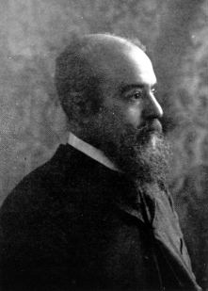
Pareto Chart
A Pareto chart is a type of chart, where individual values are represented in descending order by bars, and the cumulative total is represented by the line.
The purpose of the Pareto chart is to highlight the most important among a (typically large) set of factors.

Slide 2
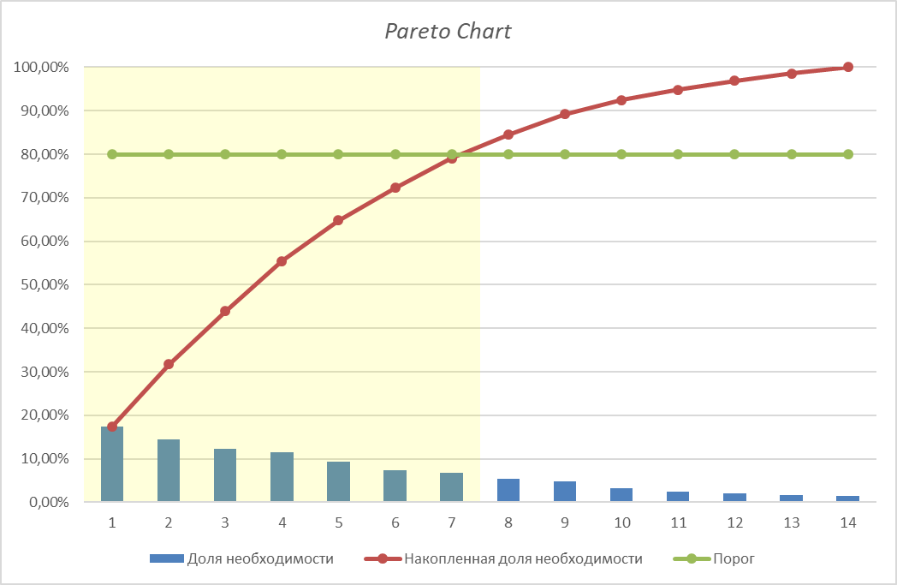
Statistic source: The results of an online survey of potential users conducted via Google Docs.

Slide 3
The MOST Important problems
№ | Problem | Frequency | %
1 | Problems with finding the necessary service | 135 | 17,35
2 | Lack of information about available services | 112 | 14,40
3 | The challenge of choosing between several service options | 95 | 12,21
4 | It is not possible to assess the quality of the service provided | 89 | 11,44
5 | Issues with getting to the service providers (there is no mark on the map) | 73 | 9,38
6 | It's hard to follow sales and events | 58 | 7,46
7 | No place to post a review about service you have used | 53 | 6,81

Slide 4
OTHER PROBLEMS
№ | Problem | Frequency | %
8 | Lack of feedback with clients | 42 | 5,40
9 | Not enough opportunities to promote your own services | 37 | 4,76
10 | Hard to remember all interesting services | 25 | 3,21
11 | Inability to share information about the services with a friend | 19 | 2,44
12 | Absence of search engine for proposals for the provision of a range of services | 16 | 2,06
13 | Inaccuracies in the approximate estimation of the cost and the term of the service | 13 | 1,67
14 | Insufficient number of shares from service providers | 11 | 1,41

